Slide 1



Online Webinar
Heat on wheels concept
Enabling data centre waste heat use without
direct district heating connection
8 October 2026, 11:00 - 12:30 CET
www.thunderproject.eu

Slide 2







Stefano Barberis
Senior Mechanical Engineer
University of Genova
Moderator
Mirella Berry
Innovation Manager
Water Horizon
Lucía Gallego Florencio
Energy Innovation Engineer
Veolia Spain
Laura Fernandes Junasová
Project Manager
Euroheat & Power
Burcu Ünlütürk
Project Manager
IVL Research Institute
Agenda

Slide 3
Submit your questions using the Q&A box
The recording of the webinar will be uploaded to:
    www.thunderproject.eu
    Euroheat & Power’s YouTube channel (THUNDER folder)
    Sent to all the registered participants via email
Practical note

Slide 4

Stefano Barberis
Senior Mechanical Engineer
University of Genova
Heat on Wheels concept for data centre waste heat recovery

Slide 5

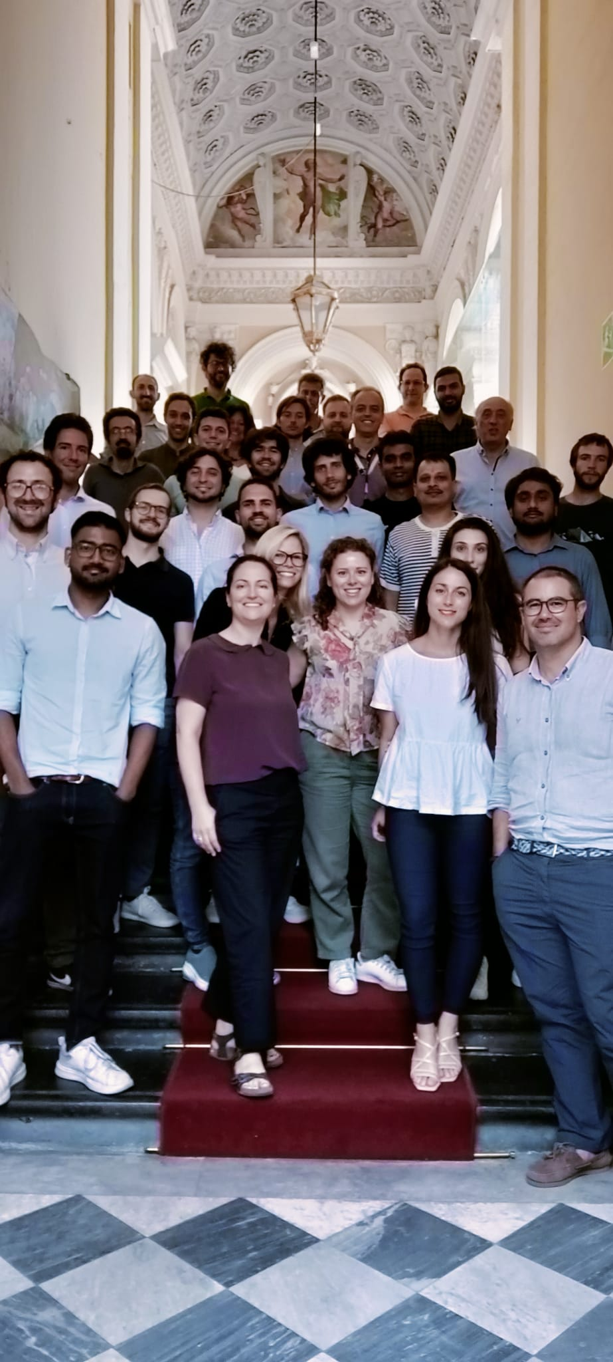
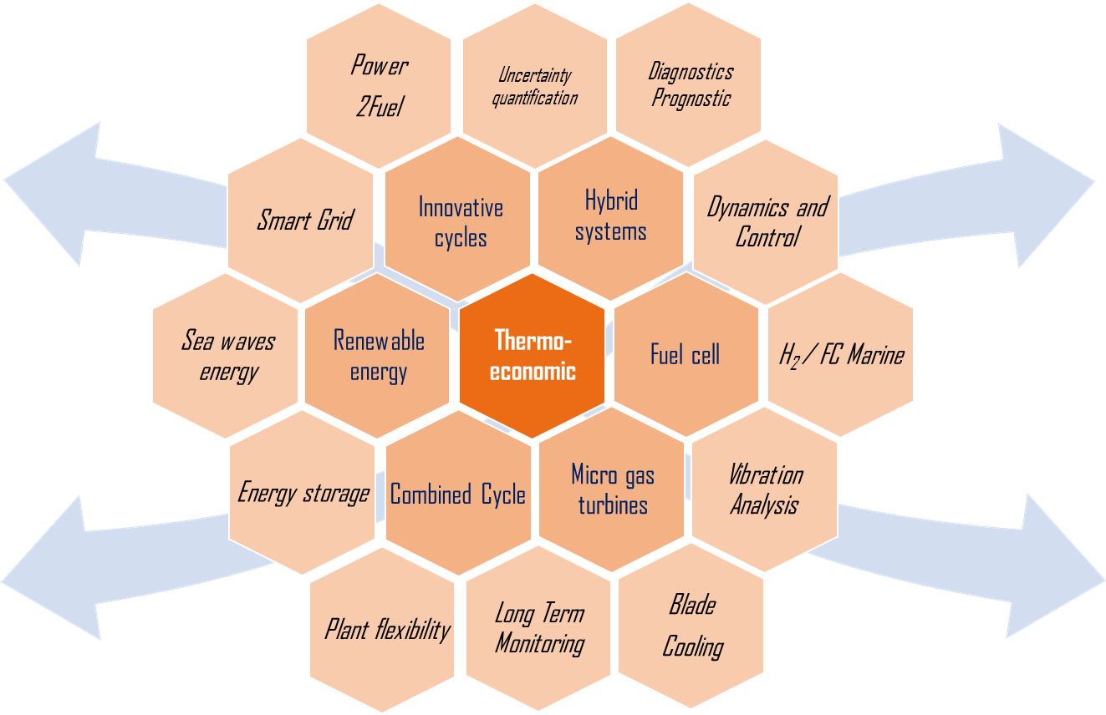

TPG UNIGE
https://tpg.unige.eu/
Established in 1998 - Staff: 30 people
Publications, Awards, Patents, Spin-off
>350 Papers, >250 Journals (1998-2023)
18 International Awards (1998-2023)
19 patents (1998-2020)
2 spin off companies (BluEnergyRevolution, SIT Technologies)
Own modelling tools
Experimental Facilities
EU projects experience

Slide 6

Table of contents
What is Heat on Wheels?
Examples of Case Studies
When Can It Fly?

Slide 7
What is Heat on Wheels?
Mobile Thermal Energy Storage (M-TES) transports industrial waste heat in phase-change material (PCM) containers via truck, rail or ship — delivering it to buildings or district heating networks not connected to fixed pipelines.
THE CYCLE
1
Charge: hot fluid from industrial source melts the PCM in an ISO container
Around 50% of industrial energy in industrialised countries is lost as waste heat. At the same time, nearby buildings burn fossil fuels for heating. M-TES bridges this gap where a pipeline would be too expensive or impractical.
2
Transport: truck carries the charged container to the end user
3
Discharge: heating water flows through the container, extracts heat as PCM solidifies
ADVANTAGE
IDEAL CONTEXT
Avoids costly pipeline infrastructure · adds flexibility · serves isolated users
Source and sink separated by topographic or urban constraints · short–medium distances
4
Return: empty container goes back for the next charge cycle

Slide 8
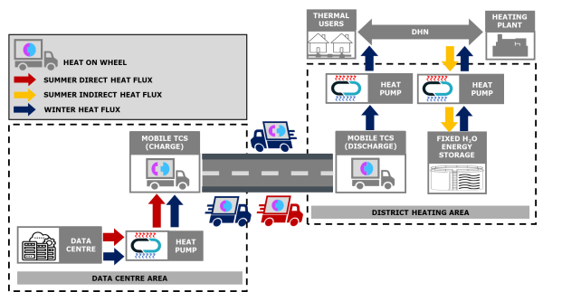
Why Heat on Wheels in THUNDER?
WHEN YOU DO HAVE AVAILABLE CHEAP AND ABUNDANT WASTE HEAT BUT INTEGRATION CAN POSE CHALLENGES AT BUILDING/LOCAL DHN LEVEL

Slide 9
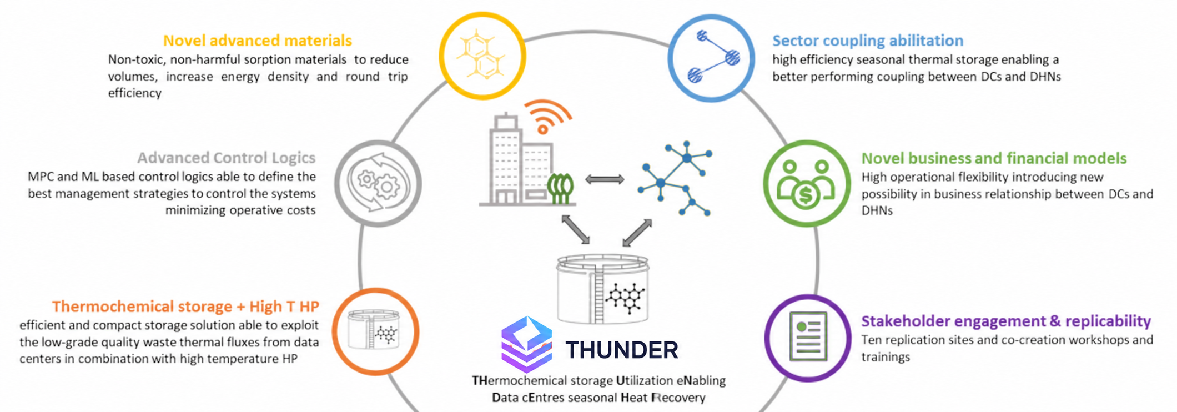
WHAT IS THUNDER

Slide 10
What is Heat on Wheels?
Storage materials & key numbers
Three types of thermal storage
KEY OPERATIONAL NUMBERS
Sensible (hot water)
Container capacity
1.5–4 MWhth
~50 kWh/t · cheap & simple · economic only up to ~15 km
Standard container
20-ft ISO
Latent (PCM) ← HoW focus
Average source–sink distance
7.5 km
100–130 kWh/t · 2–3× denser than water · economic up to ~30 km
Max economic (urban, diesel)
~20 km
Max economic (EV/RNG truck)
up to 50 km
Thermochemical (TCM) ← HoW focus
Transport energy loss
~3.5%
Highest density · minimal transport losses · less mature technology
PCM/TCM capital cost + transport = over 60% of total system cost — the single biggest economic challenge.

Slide 11
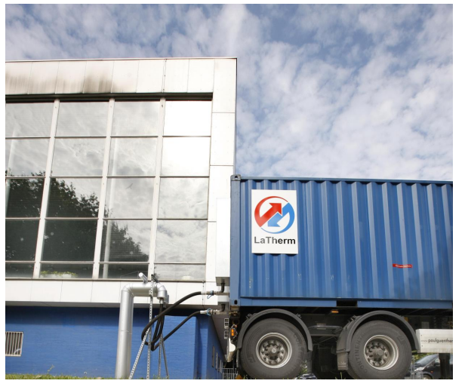
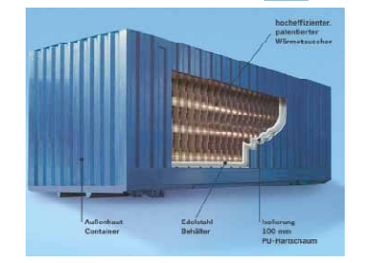
Examples of Case Studies
European Pioneers
LaTherm – Dortmund (2009+)
TransHeat / Alfred Schneider
Source
Waste heat from a municipal swimming pool boiler plant
Industrial-grade containers supplied to food industry clients (incl. LSG Sky Chefs). Focused on barium hydroxide octahydrate (78 °C) as PCM — higher temperature, suited for industrial process heat.
PCM
Sodium acetate trihydrate (58.5 °C)
Distance
~9 km · 2.5 MWh per container
Impact
First commercial delivery Nov 2009; launched the HoW commercial concept
Container types
6 sizes up to 40-ft
German school case: biomass boiler surplus heat → school district, ~10 km, similar PCM
Temperature range
58–120 °C
Market focus
Food, hospital, agro sectors
→ Demonstrated that different PCMs can expand the addressable temperature window
https://www.umweltinnovationsprogramm.de/projekte/mobile-trassenlose-waermeversorgung

Slide 12
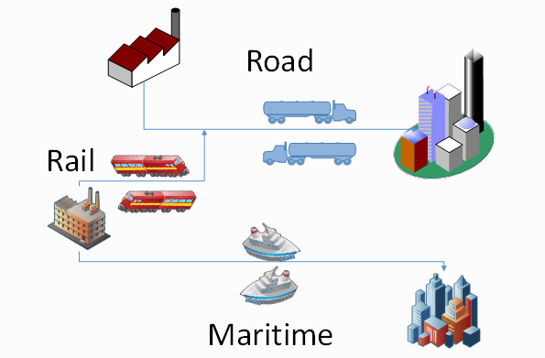
Examples of Case Studies
Scandinavian Research Pilots
KTH – Sandviken / Högbo (2013–15)
Wang / Mälardalen – Årla (2010)
Swedish Energy Agency · "Heat on Wheels" project
PhD thesis · Mälardalen University
Source
Sandvik steel plant + Stora Enso Fors Bruk paper mill
Source
CHP district heating plant
Sink
GävleEnergi district heating network
PCM
Polyethylene glycol (PEG) / expanded graphite composite — enhanced thermal conductivity
PCM
Erythritol (C₄H₁₀O₄, melting 118 °C) — high-energy latent storage
Distance
7.6 km (Högbo route)
Sink
Isolated buildings and small industrial users outside DHN coverage
LCOH RANGE
Key contributions
470
1 380
→ First systematic M-TES simulation model for distributed heating
SEK/MWh (best)
SEK/MWh (worst)
→ Showed PEG/EG composite triples effective thermal conductivity vs pure PEG
Competitive when heat purchase price ≥ 300 SEK/MWh and containers > 5 trips/week
→ Validated that M-TES is economic up to ~30 km with efficient heat loading
Sweden alone estimates ~10 TWh/year of recoverable industrial waste heat
SCANDINAVIAN CASE STUDIES INTERESTING FOR LOW COST DHN THERMAL ENERGY

Slide 13
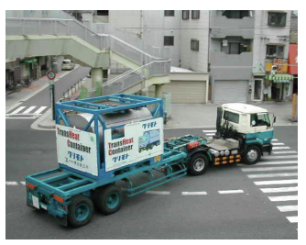
Examples of Case Studies
Japan, Canada & Italy
Japan – Three National Demos (NEDO)
SURREY BC, CANADA (2021)
I
Sanyo → Aluminum factory · 20 km
Shehadeh et al. — integration of M-TES into local district energy network using diesel vs EV/RNG trucks
PCM: erythritol · process heat recovery · first large-scale demo
Distance range
15–45 km
II
Sewage sludge → Air conditioning · 2.5 km
LCOTE (diesel)
$42–$110 CAD/MWh
Absorption chiller + M-TES · precursor of Cold on Wheels
EV/RNG advantage
+20 km range & lower CO₂
III
Furnace → Neighboring factory · 3 km
Short-range industrial symbiosis · high utilisation rate
A2A Life Ventures (Italy)
First Italian integrated open-innovation company (launched 2025) backed by A2A multiutility — manages both district heating networks and industrial heat plants.
→ Ideal HoW testbed: source + sink + logistics integration under one umbrella
https://www.sciencedirect.com/science/article/pii/S0378778822007083

Slide 14
Cold on Wheels
The cooling analogue of M-TES
Key applications & examples
THE CONCEPT
Instead of transporting heat, transport coldness: containers charged with cold PCMs are delivered to cooling demand points — replacing or supplementing chiller installations.
Japan Demo II — Absorption Chiller
Sewage waste heat drives absorption chiller → cold stored in M-TES container → air conditioning delivery at 2.5 km. Proof-of-concept for "cold from waste heat."
Pharma & food cold chain
COLD STORAGE MATERIALS
Companies (va-Q-tec, Cryoport) already commercialise insulated PCM containers for pharma logistics. M-TES extends this to bulk district-scale cold delivery.
Ice / water slurries — 0 °C, highest latent heat (333 kJ/kg), lowest cost
Eutectic salt solutions — –20 to –5 °C, food & pharma cold chains
Cold PCMs (organic) — 4–15 °C range, district cooling injection
District Cooling Networks
Urban areas with peak summer cooling demand. Mobile cold storage can top up district cooling networks without extending underground pipe infrastructure.
Same success conditions as HoW — short distances, stable demand, low transport cost — plus refrigeration regulations for food-grade and pharmaceutical applications.
LIMITED REAL CASES/EXPERIMENTAL SOLUTIONS
https://www.sciencedirect.com/science/article/pii/S2352152X26009904

Slide 15
When Can It Fly?
7 conditions that make or break the economics
1
Short source–sink distance
5
Low-carbon transport vehicle
Economic limit: ~20 km (diesel), up to 50 km with EV/RNG trucks. Beyond this, transport energy & cost outweigh savings. Average deployed: 7.5 km.
Diesel trucks are viable but add CO₂. EV and RNG trucks extend the economic range and preserve the low-carbon claim — essential in carbon-priced markets.
2
Continuous & predictable demand
6
No cheaper low-carbon competitor
Requires high utilisation (>5 trips/container/week). Seasonal or intermittent heating demand means stranded container capital cost.
HoW fails if: a DH pipeline extension is cost-effective, green gas is cheap, or a heat pump can serve the sink locally. The niche disappears when alternatives close.
3
PCM capital cost below threshold
7
Enabling policy & pricing framework
PCM + transport = >60% of total system cost. Material prices must fall or system scale must increase enough for LCOTE to compete with gas or DH extension.
Waste-heat valorisation policies, a fair price for industrial residual heat, and road-use regulations for heavy thermal containers are all needed. Without them, the business case cannot be bankrolled.
4
Adequate thermal conductivity
Most organic PCMs have low conductivity (0.1–0.3 W/m·K). Without enhancement (graphite, fins, foam), charge/discharge times become uneconomically long.
Bottom line
HoW is not universally applicable. It occupies a well-defined niche: short urban distances, stable industrial surplus heat, and no pipeline alternative — a niche that is growing as cities densify and decarbonise.
https://www.mdpi.com/1996-1073/15/22/8713
https://www.mdpi.com/1996-1073/19/9/2112

Slide 16
Thank you for your attention!
Speaker: Stefano Barberis stefano.barberis@unige.it
THERMOCHEMICAL POWER GROUP
UNIVERSITY OF GENOVA (ITALY)
tpg.unige.it

Slide 17

Mirella Berry
Innovation Manager
Water Horizon
Mobile TES for heat and cooling supply

Slide 18


01/10/2026
Moving Heat 2 Cold
A mobile thermal battery by Water Horizon
Heat on Wheels webinar

Slide 19









Key figures
CREATION
LOCATION
2017
Student entrepreneur
Toulouse
South-West of France
Water Horizon
TEAM
FUNDRAISING ROUNDS
39 people
Mainly engineers & PhD
5 M€
Mar. 2022
18 M€
Nov. 2025
Deliver low-carbon cooling from (distant) waste heat
INNOVATION
TECHNOLOGY PORTEFOLIO
Thermal battery  Circular economy
Cooling as a Service Decarbonization
4 projects
National & EU-funded
2 groups
Move Heat 2 Cold Low Heat 2 Cold
DEMONSTRATION
COMMERCIAL TRACTION
2 running pilots
More to come
+200 leads
In France and abroad
water-horizon.com

Slide 20

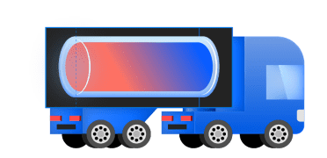
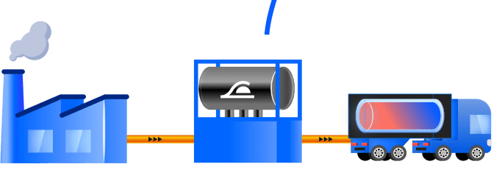
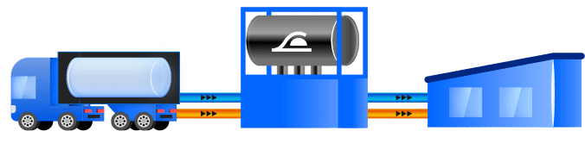
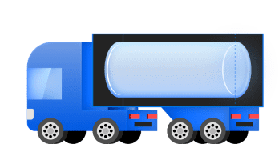


Move Heat 2 Cold Technology
We turns waste heat into transportable energy
Waste heat recovery
[
Cooling delivery
[-10°C ; +10°C]
Thermal Mobile Battery
LOW ELECTRICITY
NO UPFRONT INVESTMENT
SUSTAINABLE
EFFICIENT
10x less
Than conventional technologies
0 CAPEX
With Cooling-as-a-Service
Only salt & water
Operates in closed loop
100% reversible
No loss over time

Slide 21
How it works
Thermochemical reaction based on sorption
CHARGE
TRANSPORTATION
DISCHARGE
SALT
+
WATER
HEAT
COOLING
HEATING

Slide 22



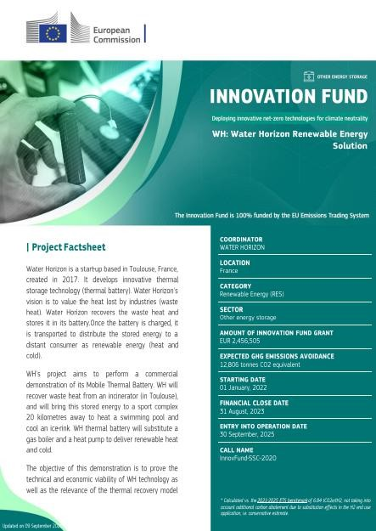
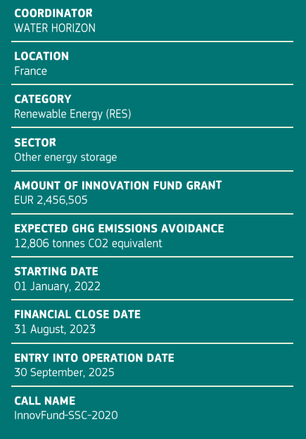

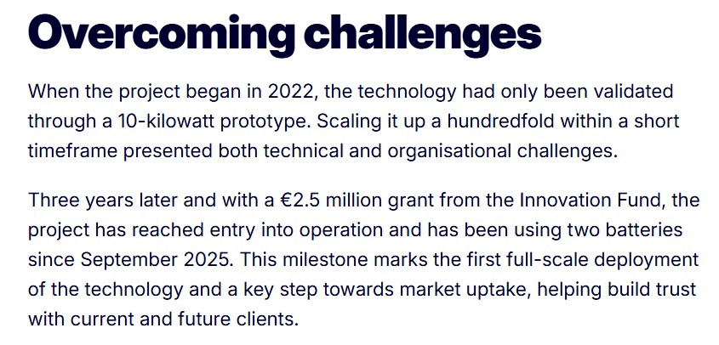


MHC Innovation Fund project
Funded by the European Union. Views and opinions expressed are however those of the author(s) only and do not necessarily reflect those of the European Union or the European Climate, Infrastructure and Environment Executive Agency (CINEA). Neither the European Union nor the granting authority can be held responsible for them.
01/10/2026
Water Horizon Présentation Officielle
5

Slide 23

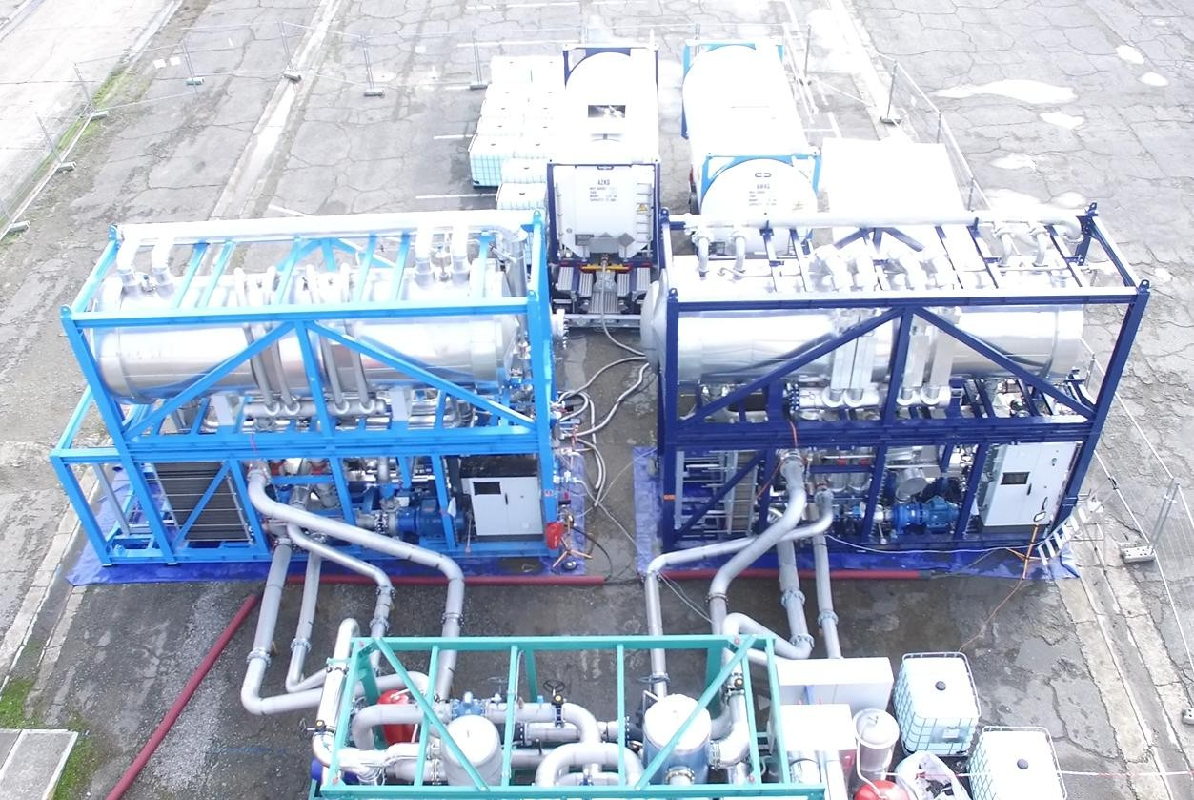
Complete system
Storage tanks
Discharging unit
Charging unit
Test bench

Slide 24


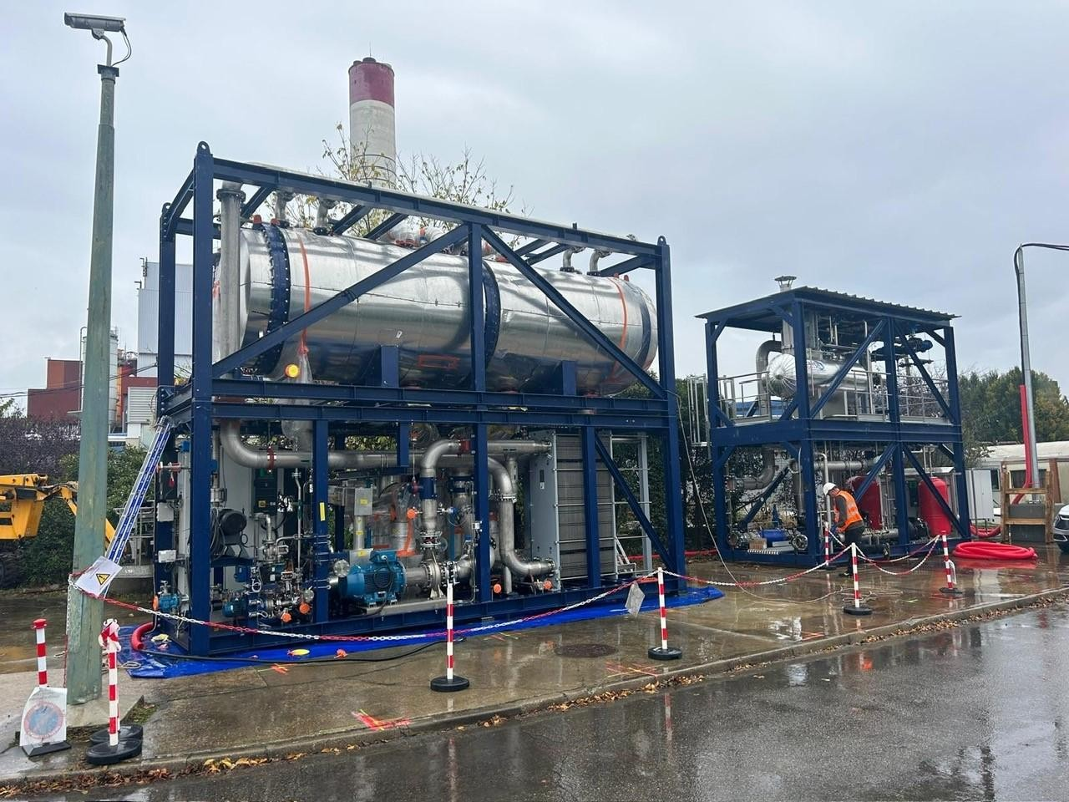
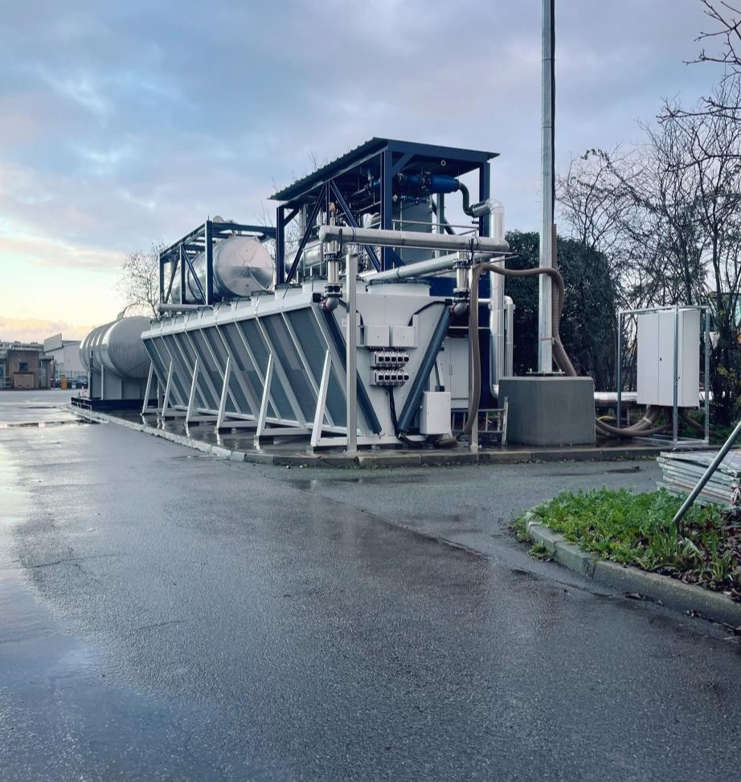
Charging unit (incinerator)

Slide 25

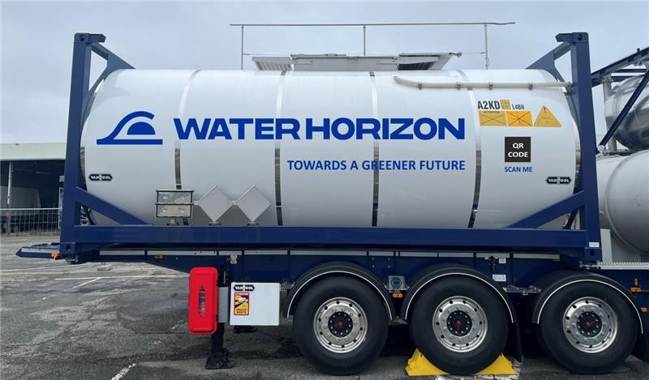
Mobile battery

Slide 26


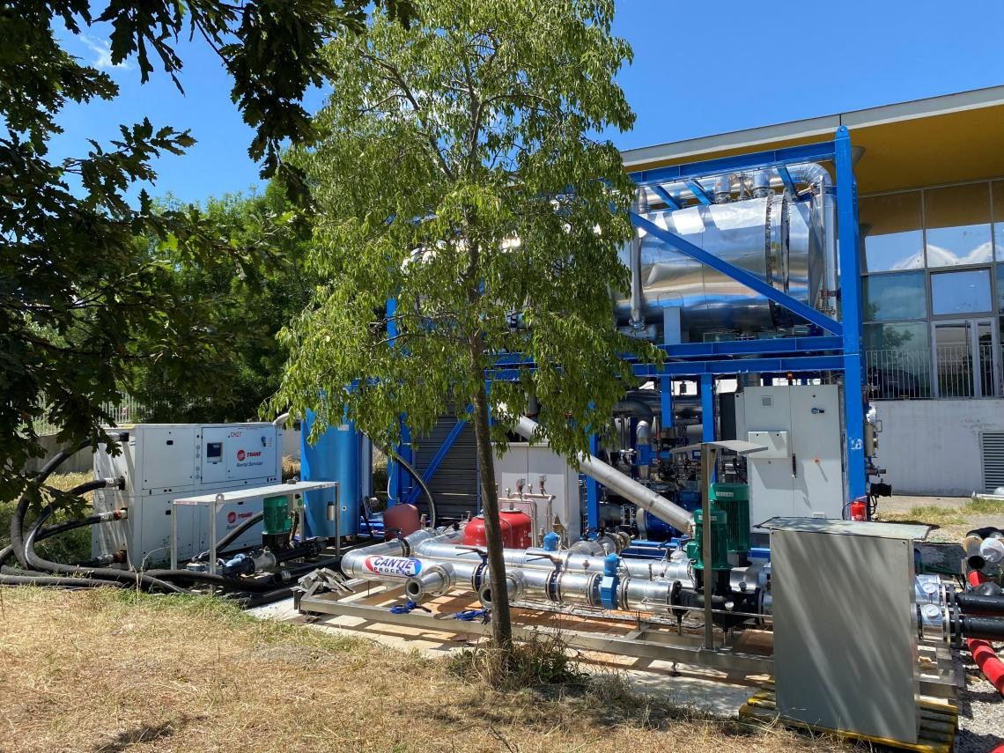
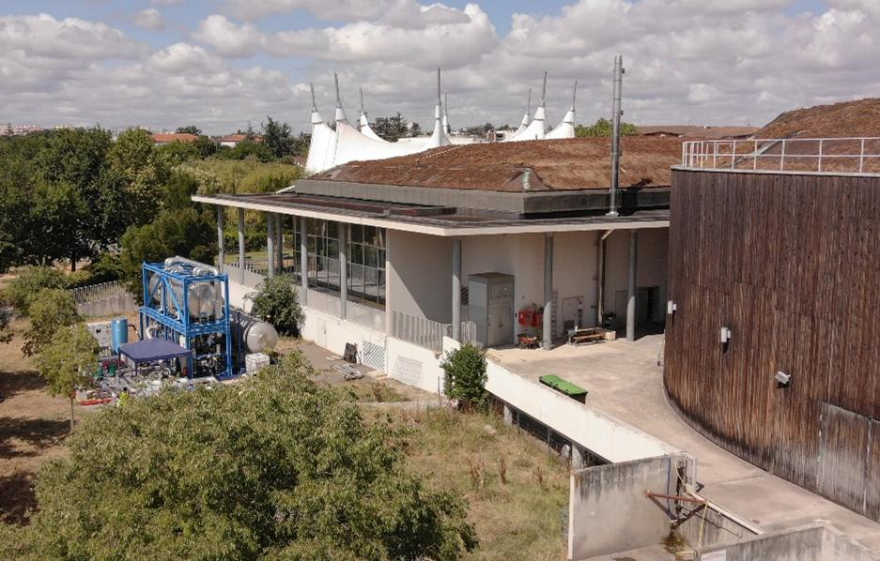
Discharging unit (sport complex)

Slide 27
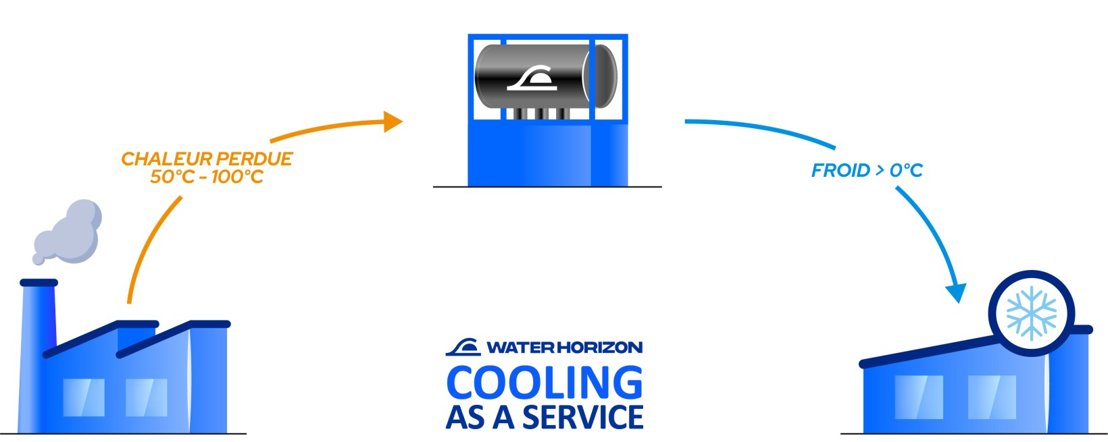


Low Heat 2 Cold Technology
We also turns waste heat low temp. into cooling
Waste heat recovery
[ ~
Cooling delivery
[ > 0°C]
DATA CENTRES REGULATION
Efficiency & thermal valorization
Current and future EU regulation
LOW ELECTRICITY
NO UPFRONT INVESTMENT
SUSTAINABLE
EFFICIENT
10x less
Than conventional technologies
0 CAPEX
With Cooling-as-a-Service
Only salt & water
Operates in closed loop
100% reversible
No loss over time

Slide 28

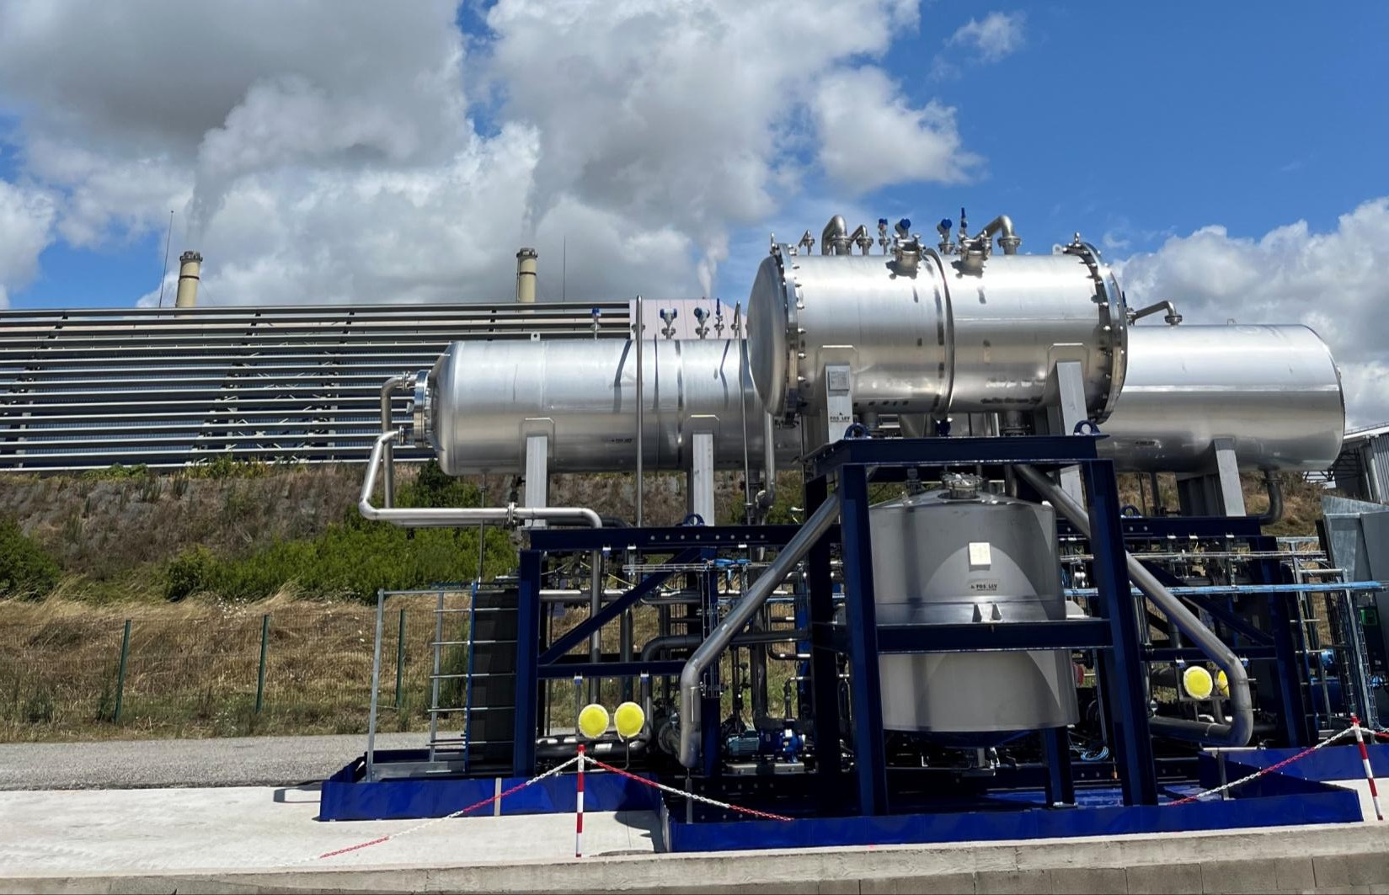
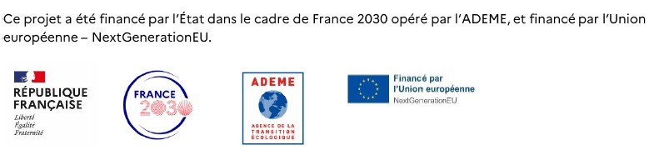
Operating unit

Slide 29
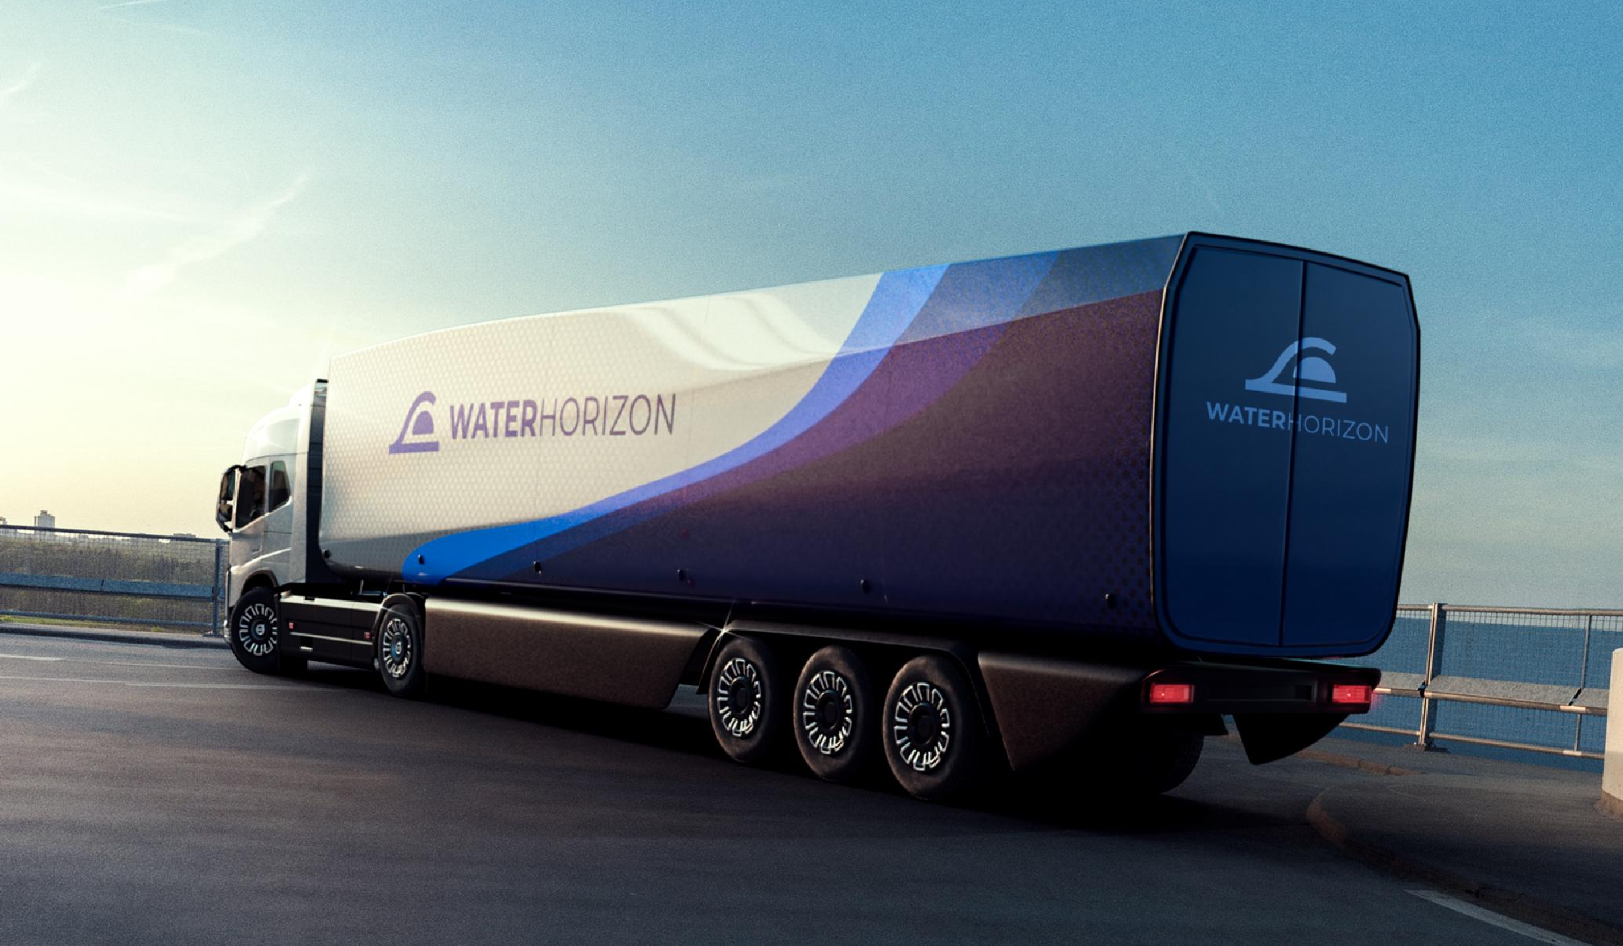

Thank you

Slide 30
Lucía Gallego Florencio
Energy Innovation Engineer
Veolia Spain
Integration Assessment , Investment Relevance & Replication Potential Across Europe

Slide 31
Integration scenarios
A - Direct connection
Data center and network are close. Heat flows from storage into the network by pipeline
B2 - Single Heat on Wheels, TCS hosted by DHN
Trucks haul heat daily during summer to TCM storage at DHN. This is the Varna demonstrator.
B1 - Single Heat on Wheels, TCS hosted by DC
Heat stored on site in summer PCM containers carry it to the network in winter.
C - Dual Heat on Wheels
Storage sits away from both sides: one fleet charges it, another delivers to the network.
Why only PCM moves?
The seasonal TCM storage needs charging temperatures up to 100 °C and vacuum or pressurised piping, which conflict with urban transport safety rules.

Slide 32
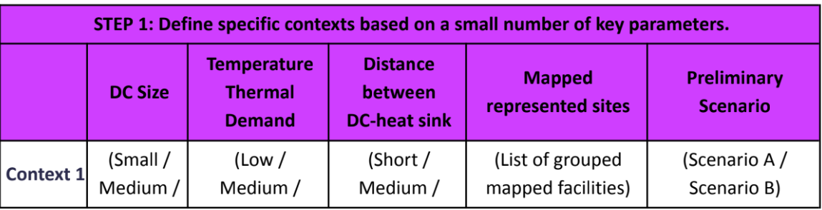
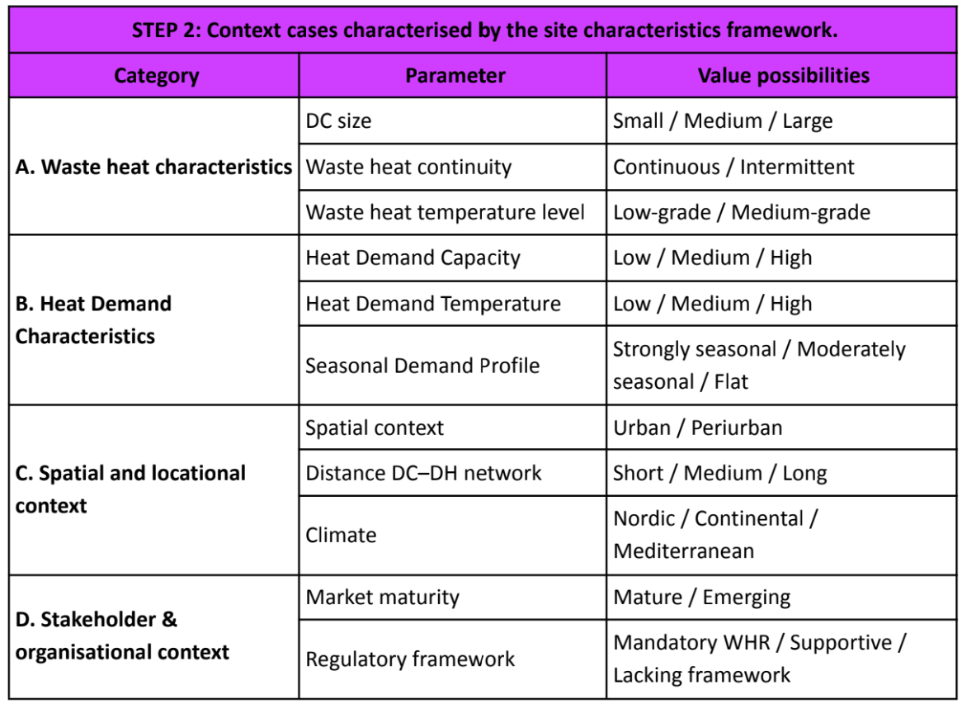
Methodology for replicability analysis
Definition of key parameters and site characteristics
Data Centre Size (Available Thermal Capacity): Determines the total volume of waste heat available for recovery.
  Values: Small (< 1 MW), Medium (1-10 MW), Large (> 10 MW).
Temperature of Thermal Demand: Represents the operating temperature of the existing District Heating Network (DHN) or the specific identified heat sink
  Values: Low (< 60 °C), Medium (60-80 °C), High (> 80 °C).
Distance between DC and Heat Sink: The primary spatial constraint that determines the logistical and economic feasibility of the integration pathway.
  Values: Short (0-2 km), Medium (>2-5 km), Long (> 5 km).

Slide 33
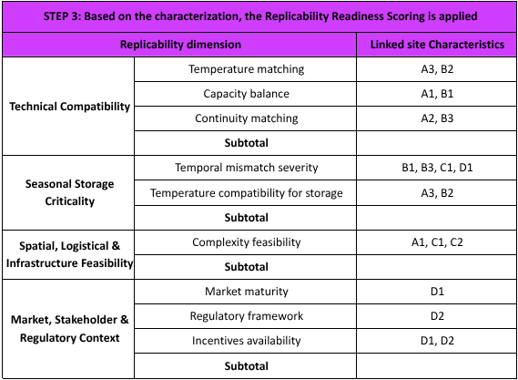
Definition of methodology for replicability analysis
Definition of replicability readiness dimensions
Dimension 1: Technical Compatibility: Assesses the fundamental thermodynamic and volumetric fit between the thermal "source" (DC) and the "sink".
Dimension 2: Seasonal Storage Criticality: This dimension is vital for validating the core THUNDER Thermochemical Material (TCM) technology.
Dimension 3: Spatial, Logistical & Infrastructure Feasibility: Evaluates the physical and operational viability of the integration pathway.
Dimension 4: Market, Stakeholder & Regulatory Context: Evaluates the external enabling environment, which is crucial for the business model's success.

Slide 34
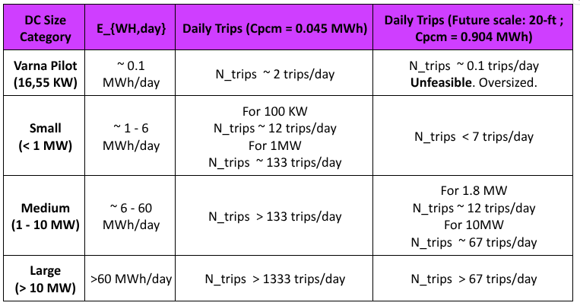
Definition of methodology for replicability analysis
Pathway configuration assessment
N_trips = E_{WH,day} / C_pcm
Logistical Constraints Formulation (The "Truck-Trip" Limit): For contexts lacking direct pipeline connections, the HoW logistical viability is dictated by:
A. Transport thermal capacity of the PCM containers.
0.045 MWh (Current Pilot Scale)
0.904 MWh (Future Commercial 20-ft)
B. Daily Recoverable Heat and Operational Window.
E_{WH,day} = P_DC * t_recovery
C. Thermal Charging Time ​
t_charge = C_pcm / P_HP​
Note: Calculations based on 1 bay. If more bays are available, divide by the total number of bays.

Slide 35
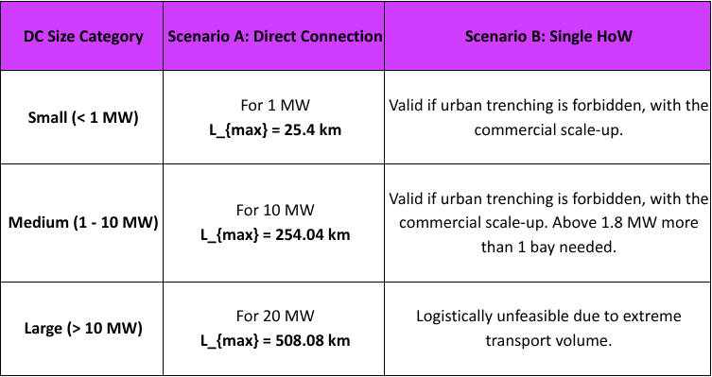
Definition of methodology for replicability analysis
Pathway configuration assessment
Investment Relevance: Direct Connection vs. HoW
A. Direct Connection: The maximum economically feasible distance for laying a direct pipeline (L_max) before the investment becomes unprofitable.
L_max = E_{WH,year} * p_heat * PB / c_pipe
B. Heat-on-Wheels: The revenue generated by a single truck trip (Rev trip) must cover the transport OPEX. The maximum viable transport distance (L max,HoW ) is calculated as:
L max,HoW = (Rev trip -c_fixed) / (2×c dist)
Note: Assumed Baselines : p_heat = 58€/MWh ; PB = 10 years ; c_pipe = 200k €/km ; c_dist = 0.03 €/km ; c_fixed = 40€ / N_trips

Slide 36

Potential Replication
Bulgaria
12
Sites · 5 contexts
Sofia, Montana, Ruse
0.13–9 MW
Southern
15
Sites · 7 contexts
8 countries, Italy to Albania & Spain
1–70 MW
East-Central
4
Sites · 3 contexts
Poland, Hungary, Moldova, Romania
0.18–3 MW
Northern
4
Sites · 3 contexts
Sweden, Denmark
0.19–37 MW
West-Central
5
Sites · 3 contexts
France, Belgium, Luxembourg, Germany
1.6–12 MW
Distances to the Heat Network
Distances range from 0 km to 15 km, and so do the answers: some sites are ready for a short pipeline, while others face dense-city gaps of 5 to 8 km.
Key Drivers
EU energy efficiency rules and national decarbonisation targets push utilities to seek decarbonised heat, shifting replication barriers away from policy and towards physical infrastructure.

Slide 37
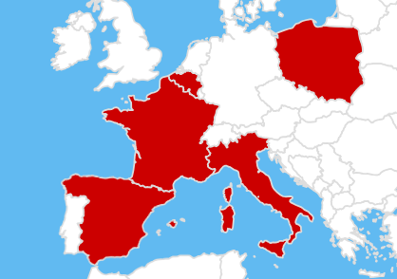
Replication Sites
10
Feasibility Studies across Europe
Characterise
Size, temperature, distance.
Acid test
Pipeline or Heat on Wheels.
Investment case
Costs, payback, ownership.
Score readiness
Technical, logistics, market.

Slide 38

Thank you for your attention!
Lucia Gallego Florencio

Slide 39

Burcu Ünlütürk
Project Manager, International Business
IVL Swedish Environmental Research Institute
Business and Ownership models:
Where does Heat on Wheels stand?

Slide 40
Agenda
1
2
3
4
Why business models matter
Ownership
Heat on Wheels in practice
Wrap-up
Key messages
Two sectors, new dependencies
The EU policy context
How we built the business model
Who controls the cooling?
The value chain and the open ownership question
What it adds to the business model
Contract elements to clarify
Open questions
Takeaways

Slide 41
Key messages
01
02
03
Business model and technical design were developed together
The data centre keeps control of its cooling
Ownership options are still being compared
Ownership discussions informed technical and logistics choices, alongside site and cost constraints.
The ownership boundary is placed at the heat exchanger.
For both Heat on Wheels and a direct connection. The value of the heat is a key open question.

Slide 42


Two sectors that never had to rely on each other
Data centres
District heating
THUNDER
(Heat on Wheels + Seasonal Storage)
Uptime and cooling reliability come first
Heat is a byproduct, rarely priced
Core business is IT services, not heat supply
Demand peaks in winter, drops in summer
Assets have long lifetime, regulated tariffs
Needs heat at network temperature

Slide 43



What the business model depends on
EU-level framework conditions that apply across European markets
Energy Efficiency Directive
Renewable Energy Directive
EED III: data centres above 1 MW must recover waste heat unless a cost-benefit analysis shows it is not feasible.
RED III: indicative target for heating and cooling networks to raise their share of renewables and waste heat.
From directives to national rules
EU co-funding
Member States transpose both directives into national law, so practical rules differ by country.
Instruments such as the Innovation Fund and LIFE can co-finance the investment.
EU policy sets the direction; the business case is built on national implementation

Slide 44



How we built the business model
Stakeholder interviews
Ownership workshop
Business Model Canvas
Contract design
Data centre, DH company, heat pump and storage manufacturer, system designer
Who could own and operate which component?
Who creates value, for whom, and how costs and revenues are shared
ReUseHeat checklist
M18 · June 2025
M36 · Dec 2026
M48 · Dec 2027
First business model and contract design
Update on the business model and contract design
Final business and contract models to support replication

Slide 45
Lesson learned: who controls the cooling?
Data centre
owns and operates
Heat recovery chain
separate circuit
What we assessed
‘Cooling as a service’: the heat off-taker runs the data centre’s cooling. Of interest to the DH operator.
Mobile PCM storage
HX
Why it did not fit
HT heat pump
For a data centre, cooling is critical to ensuring uptime. Handing over control was not acceptable.
Cooling system
Seasonal storage
Uptime promise
What we agreed
Cooling stays with the data centre. When useful, heat passes through a heat exchanger to charge the storage; otherwise cooling runs as today.
Ownership boundary at the heat exchanger

Slide 46
The value chain and the open ownership question
Data centre: keeps
control of cooling
Recovery and storage chain: ownership under assessment
Data centre
Heat exchanger
Heat on Wheels
(Mobile heat storage)
High temperature heat pump
Seasonal
heat storage
High temperature heat pump
District heating network
boundary
Option I
DH company owns the chain
Option II
A third party owns the chain
Recovered heat is integrated into its own system
Carries investment and operation of the chain
For example an ESCO: buys heat from the data centre and sells it to the DH company or others
Scalable and replicable; needs contracts on both sides
Both options are being investigated, for Heat on Wheels and for a direct connection

Slide 47

Moving heat and shifting it in time
Heat on Wheels bridges distance
Seasonal storage bridges seasons
+
From the data centre to the DH site, without a pipeline
From summer, when heat is available, to winter, when it is needed
What this means for the business model
1
Value depends on timing
2
Two assets at two locations
3
Contracts cover the whole chain
Without storage, the network can use only a small part of the heat recovered in summer.
Mobile units move between sites; the seasonal storage is fixed at the DH site. Each needs an owner and an operator.
Metering, responsibilities and payment from charging at the data centre to winter discharge into the network.

Slide 48



What Heat on Wheels adds to the business model
A new partner
New activities
New resources and costs
New questions
A logistics and transport provider becomes part of the value chain.
Charging, transport, handover and discharging of PCM units, scheduled around both sites.
Mobile PCM units and electric vehicles, and transport costs, instead of a fixed pipeline.
Who owns the mobile units? Could other customers be served?
The ownership options apply with or without Heat on Wheels; what changes is the delivery chain and its contracts

Slide 49




Contract elements to clarify for Heat on Wheels
Ownership boundary
Heat specification
Price formula
At the heat exchanger. Asset ownership, location and access rights at both sites.
Temperature and energy per PCM charge, metered at charging and discharging.
Is heat priced or free, and for how long?
Logistics and handover
Maintenance and failure
Change and exit
Who carries the risk in transit; schedules, site access, liability.
Separate O&M terms per asset; back-up when units are out of service.
Volume drops, relocation or new owner. Mobile units can partly reduce relocation risk.
Selected from the ReUseHeat checklist of 15 contract elements for urban waste heat recovery (Lygnerud, 2022)

Slide 50
Open questions we are working on
What is the heat worth?
Who carries the investment?
Today closer to a byproduct than a traded commodity. The answer affects every price formula.
Heat pumps, seasonal storage and mobile units are capital-intensive; co-funding is still part of the case.
Which customers beyond DH?
Heat on Wheels or a pipe?
Buildings off the network, industry and low-temperature users.
For the decided ownership structure, we look at both delivery options.
Next: Updated business and contract models at M36; final versions to support replication at M48

Slide 51
Takeaways for practitioners
1
Start the ownership conversation early
It affects the technical design as well as the contract.
2
Respect each party's core operations
For data centres cooling is crucial. A clear boundary at the heat exchanger helps.
3
Make the price of heat explicit
Including whether it is free, and for how long.
4
Include logistics in the contract
Heat on Wheels adds transport, handover and metering per charge.

Slide 52
A question for you
In your context, who would you expect to own the mobile storage units?
A
B
C
The data centre operator
The district heating company
A third party, e.g. an ESCO
Answer A, B or C in the chat, or tell us why later

Slide 53
Thank you for your attention!
Burcu Ünlütürk, IVL
burcu.unluturk@ivl.se

Slide 54

www.thunderproject.eu
Follow the project

Slide 55


Slide 56
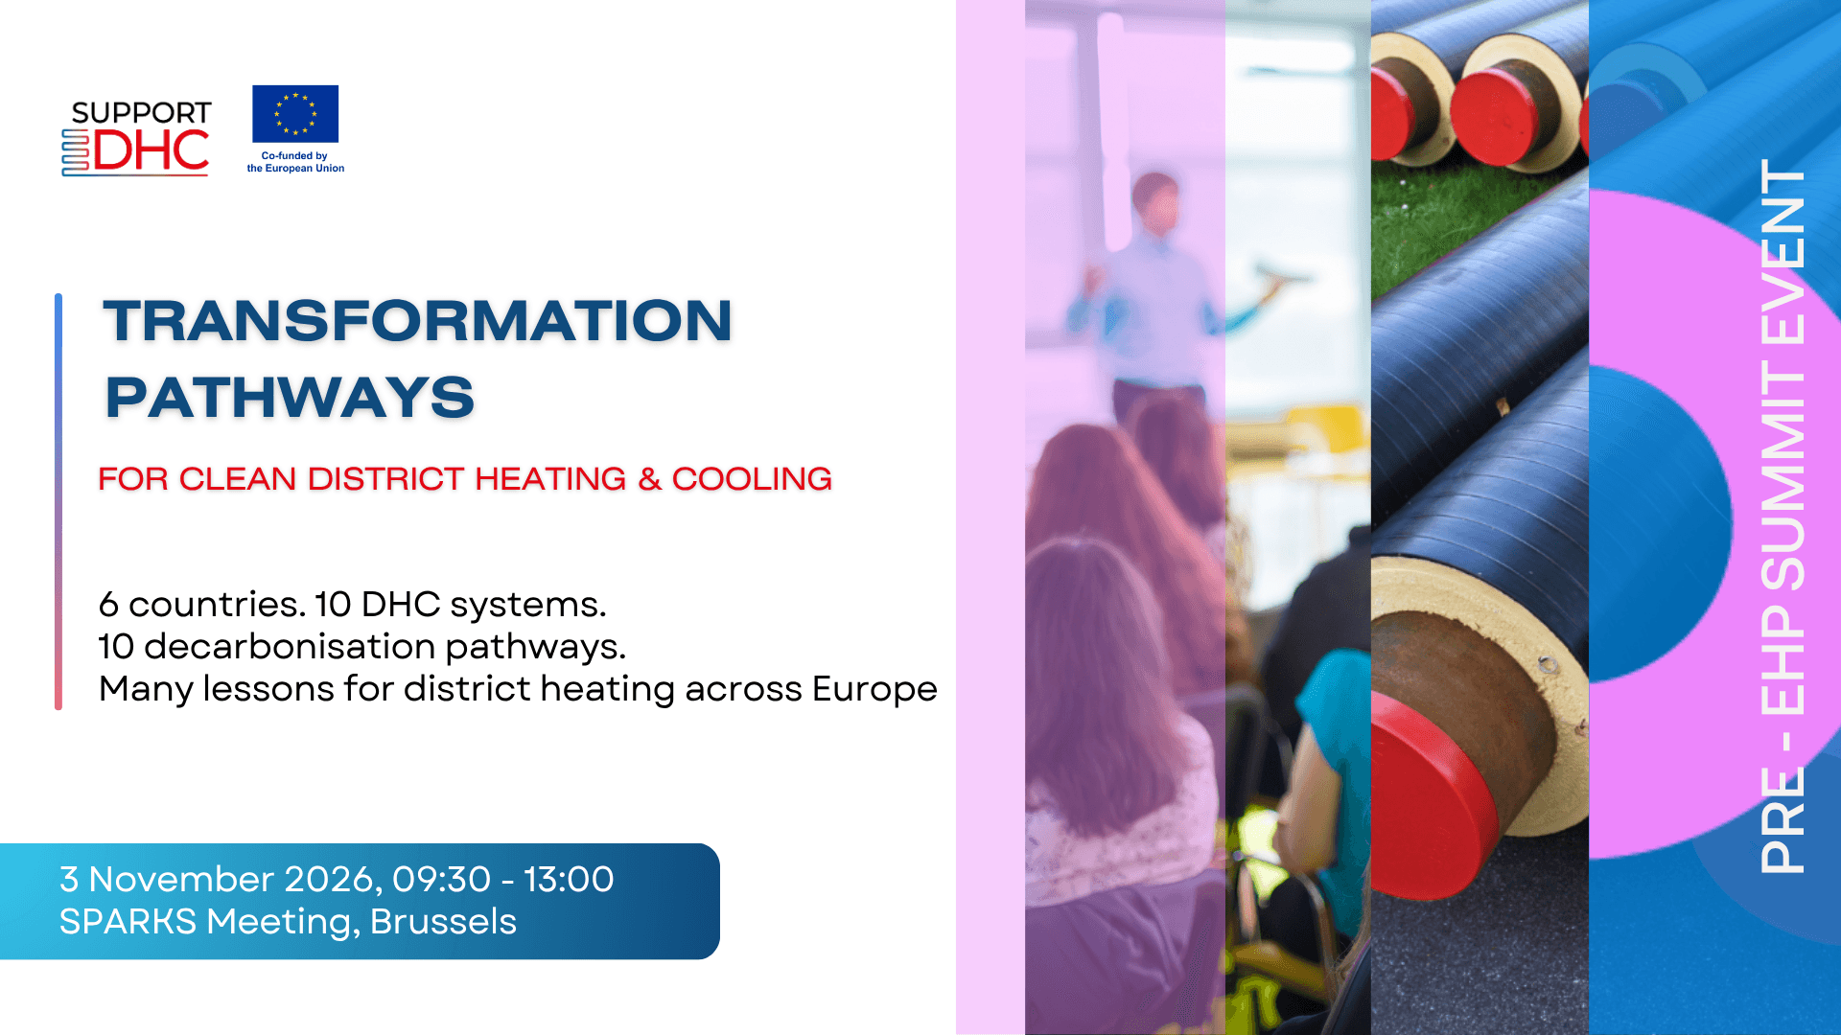

Slide 57


